Slide 1
Curiosity Browser Prototype
Sunil Vanmullem
sunil.vanmullem@cgi.com
08 July 2014

Slide 2
Background
Started from a personal interest in Mars Data
Needed an application to connect disparate sources of information about Mars.
Needed social collaborative features – Tagging, commenting and highlighting. Needed to make these sticky and easy to find. Existing interfaces are complex with few collaborative features.
Uses little known JPL API http://mars.jpl.nasa.gov/msl-raw-images/image/image_manifest.json
Links direct to MSL information – i.e. WUSTL Curiosity Notebook, PDS, JPL, mars.nasa.gov, mars.jpl.nasa.gov, whereistherovernow.
Fully functional prototype - PHP and JQuery – Open source (Github) - No Database , uses simple file based storage.
Easily customised using CSS for specific communities and citizen science themes
Collaborate

Slide 3
Links
Web app - http://www.mars-browser.co.uk/curiosityb/
Sources - https://github.com/open768/curiosity_browser
Screenshots follow ….

Slide 4
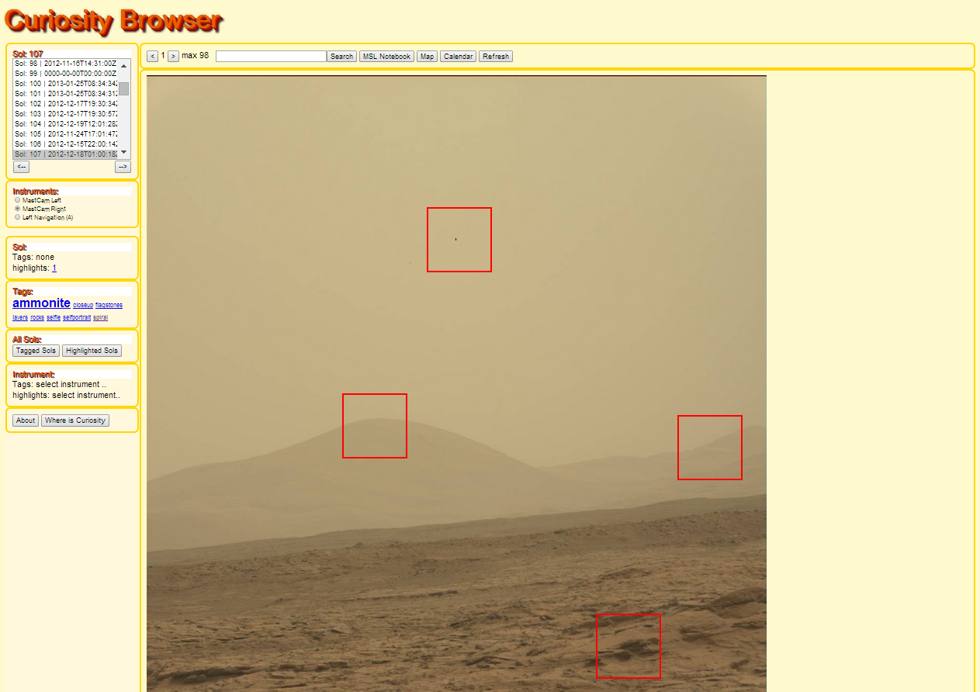
Search by product
Other useful links
Sol list
to calendar
6 browse images shown stacked for easy browsing
Instruments available for sol
Tags and highlights
highlights and tags shown to attract further collaboration
Citizen scientist Tag cloud
information
to detail screen

Slide 5
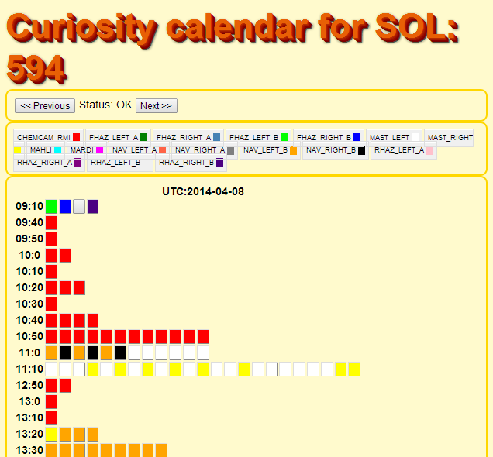
Colour coded calendar showing all products for the sol
Click thru to go to the product

Slide 6
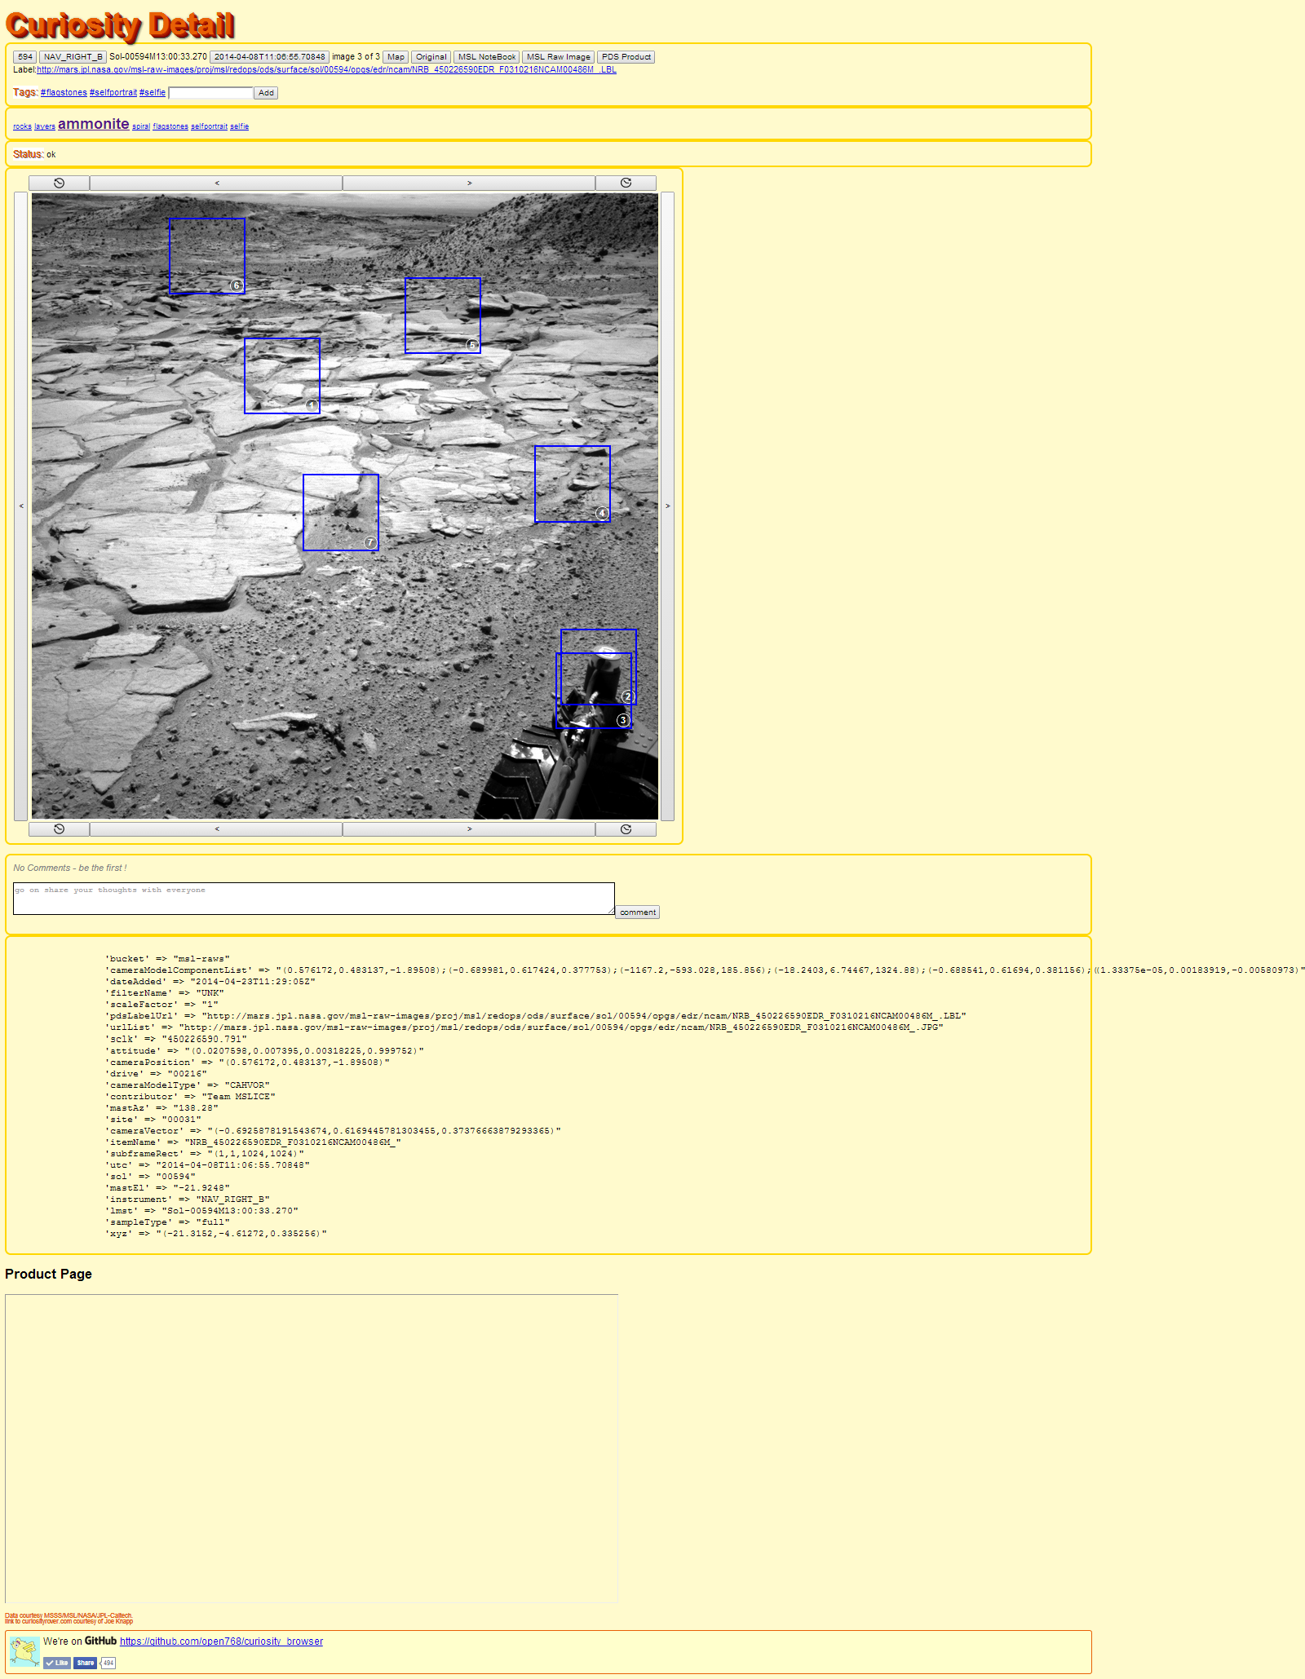
Research links
Tag Cloud
Numbered highlights

Slide 7
Numbered highlights
comments
Product data

Slide 8
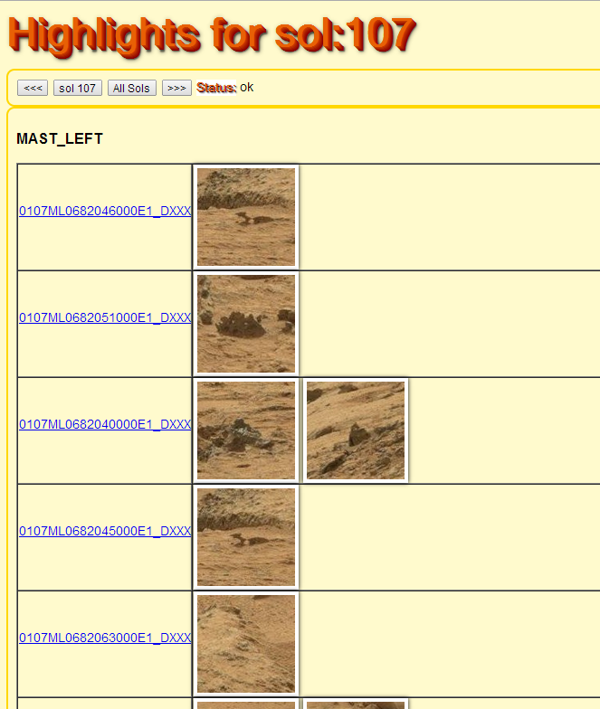
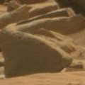
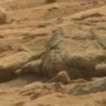
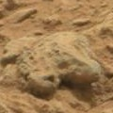
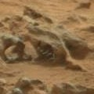
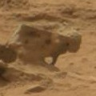
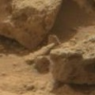
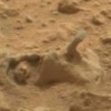
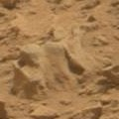
Visual reference of interesting geology

Slide 9
The Future…
Aim to become a one stop solution for citizen scientists to collaborate on Pathfinder, Spirit, Opportunity, Curiosity and Future rovers.
Plan to add more interactivity – eg whiteboards, simple image processing , panorama generation, voting, social networks.
Plan to add citizen science missions to theme collaboration according to mission. eg identify Aeolian features
Plan to link up to HiRise, Mars Express and other Mars data sources
Plan to integrate with Google Earth plugin– to display images in context with the terrain. – i.e. Street view for Mars.
Ask a Geologist –foster 2-way communication with experts, who can then escalate to the mission scientists.
Industrialise - today is a fully working prototype used to develop and demonstrate the concept.

Slide 10
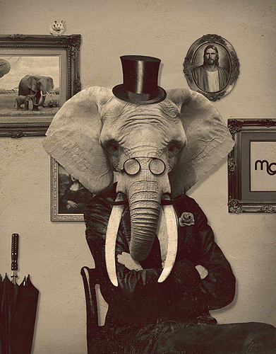
User generated content (the Elephant in the room)
Users can and will will generate content that doesn’t necessarily reflect the site owners aims or the objectives of the mission. The elephant in the room is unscientific amateur hypothesis.
The public are not experts – there is an opportunity to educate the public and increase their engagement with NASA data.
There should be clear statements that the site owner is not responsible for or associated with user generated content.
There could be a visual distinction in the application between site-owner approved and user generated content.
Community moderation, as used in facebook, twitter, should be used. Where user generated content that does not agree with the site owners aims, it will be ignored, or the community will respond. Site owners need not respond – this tactic is used effectively on NASA social media channels.
It is not appropriate to censor user generated data that does not agree with the site owners aims unless that material is defamatory, harrasing, threatening, inciting hate or violence or other illegal forms of expression.
There should be layers of triage between user generated content and the mission staff to reduce the possibility of rogue user generated content from impacting mission functions. eg “ask a geologist” could have several levels of triage: student geologist, expert geologist, Nasa Scientist, and finally Mission Scientist
Even a single lightbulb moment makes this kind of 2-way dialogue worth it. Eg genuine science targets could be identified by citizen scientists that were not identified by the mission.

Slide 11
Our commitment to you We approach every engagement with one objective in mind: to help clients succeed

